Slide 1
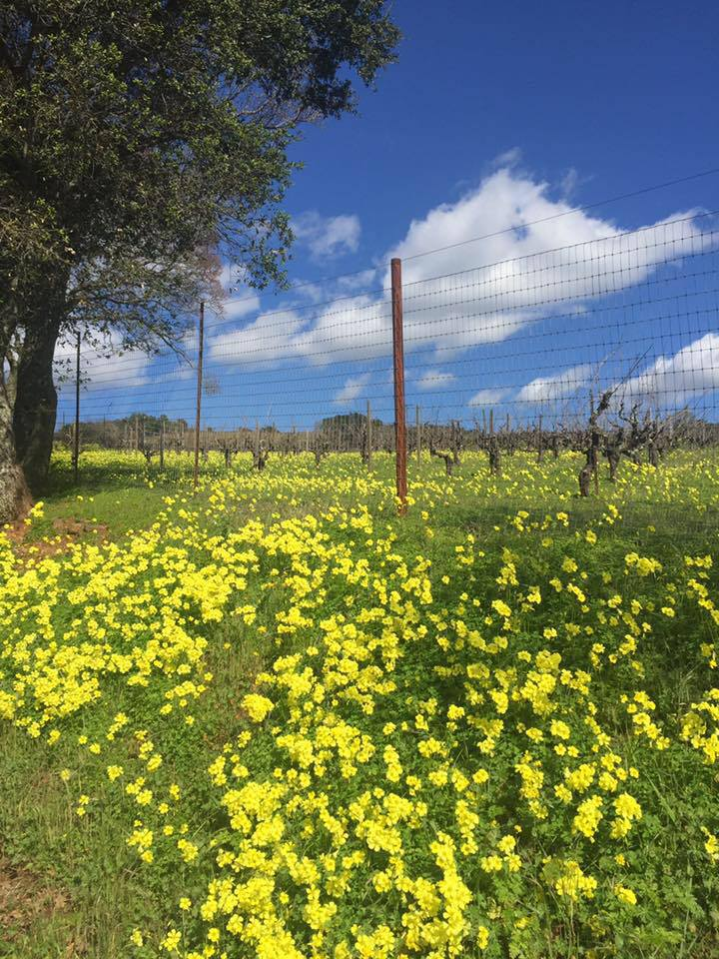
Glen Ellen Forum
Many Voices … One Community
May 2018 Meeting
Welcome everyone!
www.glenellenca.org
forum@glenellenca.org
Glen Ellen Forum – facebook page

Slide 2
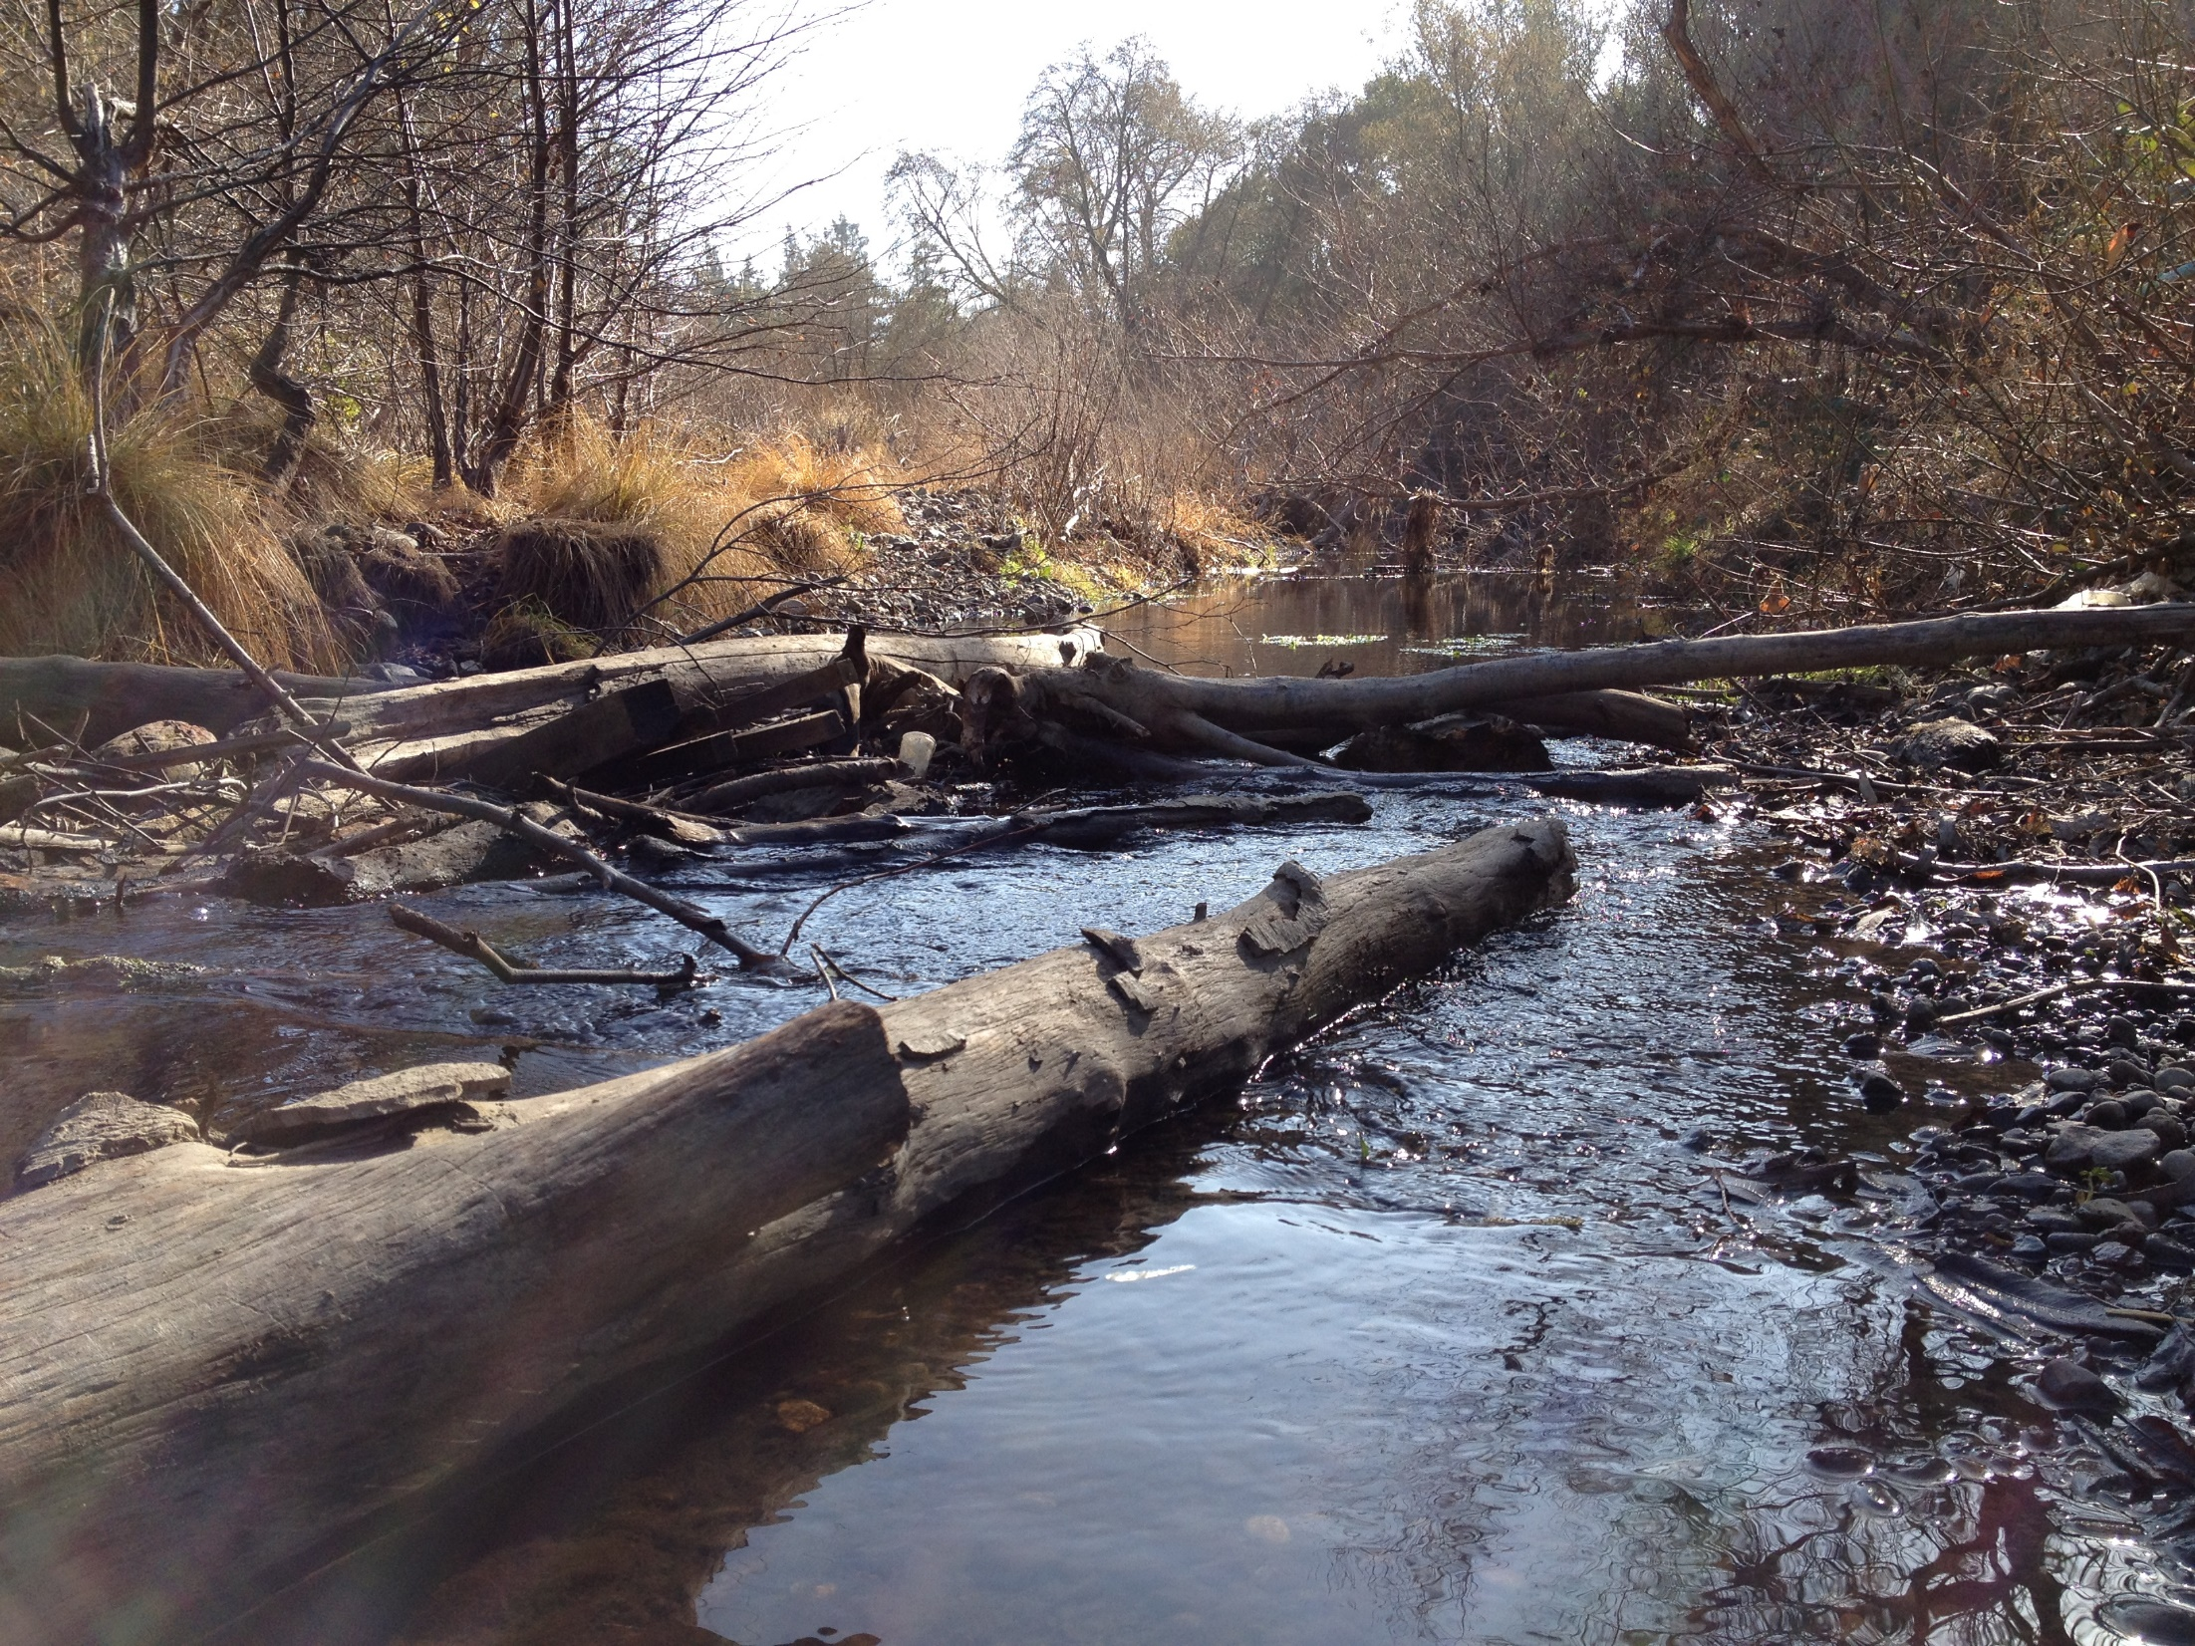
Agenda
Opening
Norm Clover Whisper Creek Developers & Grizzly Log Builders
Caitlin Cornwall Sustainable Sonoma
Vicki Hill Sonoma Valley Groundwater Sustainability Agency (GSA) Advisory Committee
Traffic & Safety
SDC/Eldridge
Projects
Community Engagement
Advisory Council Exploration
Commerce & Tourism
Garden
Environmental
Points to Mention
AOB/Questions/Discussion
Closing

Slide 3
Points to mention
Elections - Steering committee – 5 positions
- Committee Chairs/Vice chairs
Non-Profit Status - We are now a non-profit (all paperwork is complete)
- Convene Board of Directors (oversight)
Website - New calendar page
- Bi-lingual option (English/Spanish & more)
- Business listing under way – support small local businesses
- Continuous work
New email app - Allows instant signup and unsubscribe
- More professional presentation
- Needed as we have grown in size
Next Community meal - In June (Confirming date)
- Partnering with La Luz - http://www.laluzcenter.org/
- Free (Donations welcome)
Home & Ranch Readiness Summit Santa Rosa - May 17 – 19 - RanchReadinessDay.com
Sonoma V. Emergency Preparedness Fair Saturday, May 19th - 10 a.m. to 2 p.m. http://svchc.org/

Slide 4
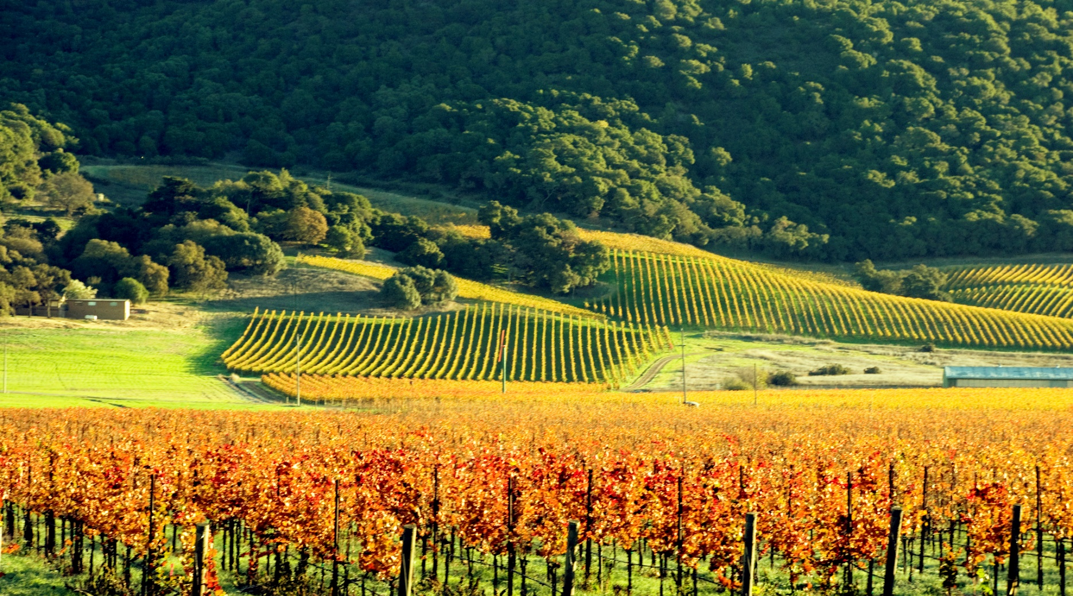
“It always seems impossible until it is done”
Nelson Mandela on his anti-Apartheid efforts.

Slide 5
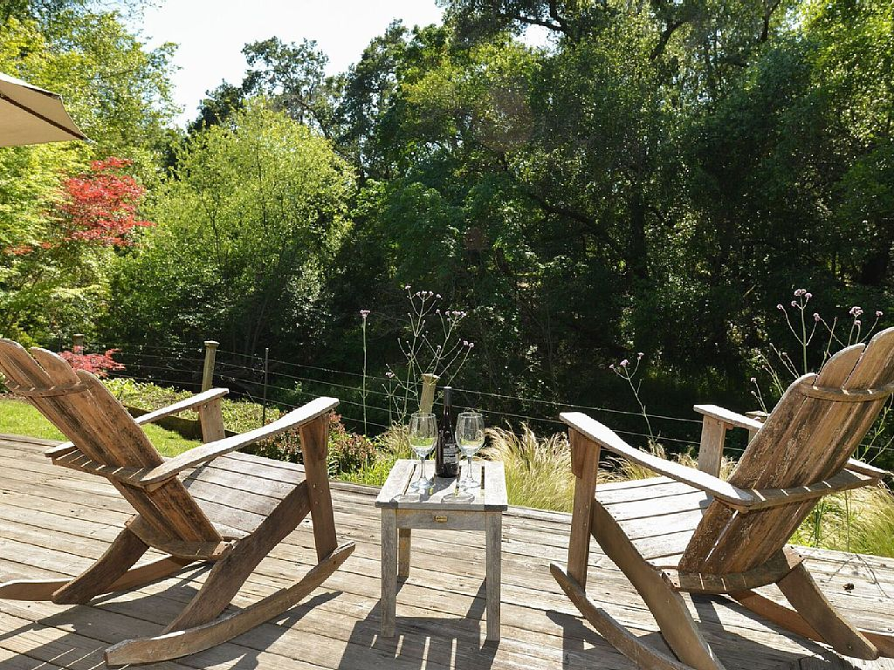
Join us at our next meeting in June on the 4th 6.30 p.m. Garden Court Café
Thank you!

